Slide 1
New data & new questions: Examining the FIAT-Q-SF and understanding FAP assessment in a process-based era
Cory Stanton, Jonathan Singer, Brandon Sanford, & William Follette
University of Nevada, Reno

Slide 2
Disclosures:
Cory Stanton, Jonathan Singer, Brandon Sanford
We have not received and will not receive any commercial support related to this presentation or the work presented in this presentation
William Follette
Receives book royalties from Springer for “A Guide to Functional Analytic Psychotherapy: Awareness, Courage, Love, and Behaviorism” – no compensation directly related to this presentation

Slide 3
Agenda
The unit of analysis in FAP and attempts to conceptualize processes of change
The FIAT system and the FIAT-Q-SF
Brief presentation of data
Understanding findings from a process-based therapy (PBT) perspective

Slide 4
The unit of analysis in FAP
Functional Analytic Psychotherapy (FAP; Kohlenberg & Tsai, 1991; Tsai, Kohlenberg, Kanter, Kohlenberg, Follette, & Callaghan, 2008)
A contextual behavioral approach to psychotherapy focused on contingent responding in the context of an intimate therapeutic relationship (Follette, Callaghan, & Naugle, 1996)
In particular, there is promising evidence for the use of reinforcement of behavioral improvements (Singh & O’Brien, 2018)

Slide 5
The unit of analysis in FAP
There’s a lot to care about:
Client
Therapist
Dyad
Proximal verbal community
Extended social / cultural community
What’s the best way to organize theory?

Slide 6
The unit of analysis in FAP
Purely idiographic a la traditional behavior analysis
Awareness, Courage, and Love (Maitland, Kanter, Manbeck, & Kuczynski, 2017)
The Functional Idiographic Assessment Template System (Callaghan, 2006)

Slide 7
The FIAT System (Callaghan, 2006)
Assertiveness
Bidirectional communication
Conflict resolution
Disclosures
Emotional expression

Slide 8
The FIAT System (Darrow, Callaghan, Bonow, & Follette, 2014)
FIAT-Q-SF
32 items from the FIAT-Q
Potential use as a process measure to represent gains in interpersonal repertoires
But…
Only one published study (the original) examining its psychometrics in depth, and with some things to consider

Slide 9
The Present Study
“…the current results must be reproduced in a test-retest sample with less participant attrition before a strong conclusion can be drawn” (Darrow, Bonow, Callaghan, & Follette, 2014, pp. 13)

Slide 10
Method
Undergraduate psychology students completed cross-sectional survey at two time points, one month apart
65% female, 62.7% white
Generally healthy – obesity (6.5%), some hx of illicit drug use (29.8%)
Part of a broader project validating a new quality of life measure

Slide 11
Method
Measures
FIAT-Q-SF: Interpersonal Functioning
1 item excluded
Clinical Research Inventory (CRI; QoL measure under development in our lab)
Short-Form 36 (SF-36v2; Ware, Kosinki, Bjorner, Turner-Bowker, Gandek, & Maruish, 2007)
Valuing Questionnaire (VQ; Smout, Davies, Burns, & Christie, 2014)
Ryff Purpose in Life Scale (Ryff, 1989)
Notes:
“I have problems with my emotions”

Slide 12
Results
Time 1 = Ran 645, data cleaning → 640
Time 2 = Ran 569, data cleaning → 526

Slide 13
Results – Correlations
Time 1 (640) | Ryff PIL | QoL | SF36 Phys | SF36 Mental | VQ Progress | VQ Obstruct
FIAT | .488** | -.645** | -.121* | -.405** | -.513** | .547**
Time 2 (526) | Ryff PIL | QoL | SF36 Phys | SF36 Mental | VQ Progress | VQ Obstruct | FIAT T1
FIAT | .516** | -.591** | -.086 | -.413** | -.521** | .641** | .772**
Notes:
In data screening, sample was shown to be skewed healthy on the SF36 Phys, which makes sense – it’s a college sample
*Note: SF36 Phys n = 304 Time 1, 259 Time 2, due to survey issue

Slide 14
Results – Factor Structure
EFA on time 1
KMO Sampling Adequacy: .871
Bartlett’s Test: χ2 = 7498.204, df = 465, p < .001
Same as Darrow et al. 2014, given the hypothesized non-orthogonality of factors, oblique geomin rotation was used
Notes:
The Kaiser-Meyer-Olkin Measure of Sampling Adequacy is a statistic that indicates the proportion of variance in your variables that might be caused by underlying factors. High values (close to 1.0) generally indicate that a factor analysis may be useful with your data. If the value is less than 0.50, the results of the factor analysis probably won't be very useful.
Bartlett's test of sphericity tests the hypothesis that your correlation matrix is an identity matrix, which would indicate that your variables are unrelated and therefore unsuitable for structure detection. Small values (less than 0.05) of the significance level indicate that a factor analysis may be useful with your data.

Slide 15
Results – Factor Structure
Original:
Avoidance of Interpersonal Intimacy, Argumentativeness or Disagreement, Connection and Reciprocity, Conflict Aversion, Emotional Experience and Expression, & Excessive Expressivity
Present Study:
Avoiding Intimacy, Oversharing, Conflict Aversion, Arguing & Disagreement, Providing Closeness, & Labeling Emotion
Three items removed
“I express my emotions at appropriate times and places”
“There are times when it is beneficial to argue in relationships”
“I have difficulty making conversation with others”

Slide 16
Results – Psychometrics
Subscale Reliability
.766**
.697**
.681**
.718**
.363**
.619**
Cronbach’s α
Avoiding Intimacy - .87
Oversharing - .83
Conflict Aversion - .74
Arguing & Disagreement - .85
Providing Closeness - .56
Labeling Emotion - .68
Whole scale - Cronbach’s α = .80
Test-retest – r. = .772, p < .001
Mean = 88, SDev = 22

Slide 17
Results
FIAT-Q-SF sum behaves like you would want or expect; good convergent / discriminant validity, good reliability
Factor structure differs from original publication (but not by much; biggest problem is Providing Closeness subscale)
“The traditional view of construct validity embodied by factor analytic approaches is not in line with the bottom-up approach of functional analysis” (Darrow, Bonow, Callaghan, & Follette, 2014, pp. 13-14)

Slide 18
Molenaar (2013)
“The unavoidable consequence of the ergodic theorems is that psychometrics and statistical modeling as we now know it in psychology are incomplete. What is lacking is the scientific study of the individual, his or her structure of intraindividual variation, for its own sake. Scientific psychology can only become complete if it includes the idiographic point of view, alongside the nomothetic point of view.” p. 216

Slide 19
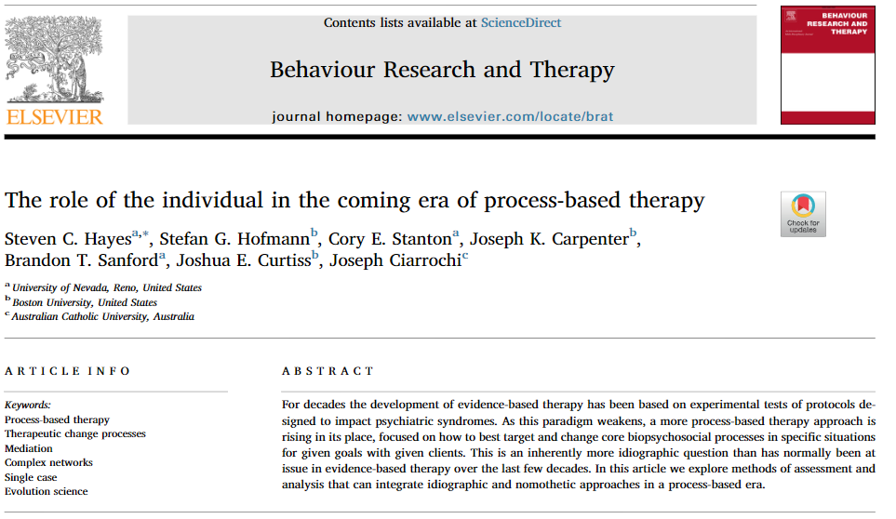
A way forward: FAP and PBT
Process-Based Therapy (PBT; Hayes & Hofmann, 2017; Hofmann & Hayes, 2018)
“What core biopsychosocial processes should be targeted with this client given this goal in this situation, and how can they most efficiently and effectively be changed?” (Hofmann & Hayes, 2018, p. 38)
Notes:
“Individual human lives are contextual and longitudinal, as are the change processes that alter these life trajectories. From a process-based point of view, practitioners need coherent and broadly applicable models of change processes that are relevant for the individual in context, that provide increased treatment utility and intervention guidance, and that simplify human complexity.”

Slide 20
A way forward: FAP and PBT
FAP is well suited as a process-based therapy
The non-orthogonality of repertoires
Focus on contextual and longitudinal change of individuals
The emergence of phenomenon at different levels of analysis (client/therapist → dyad)
Experience Sampling Methods (ESM)
Network Analysis

Slide 21
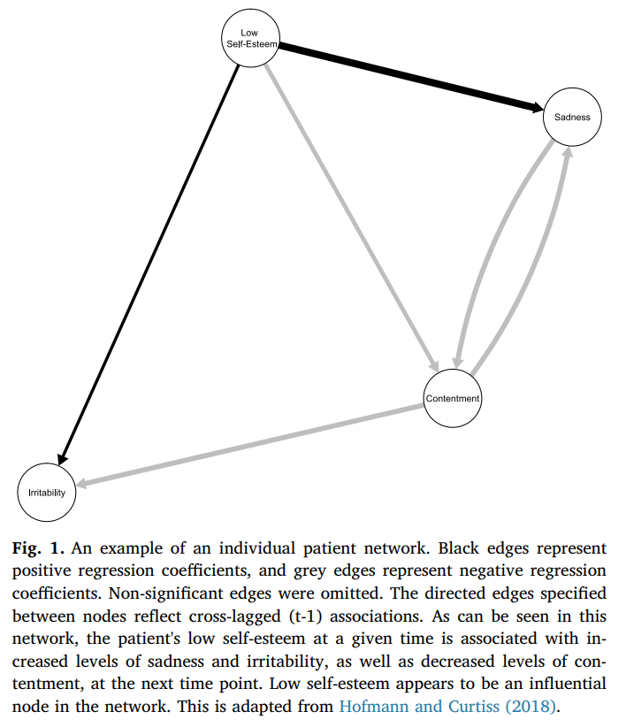

Slide 22
Next steps
Ongoing study (cross sectional, will include CFA of the FIAT-Q-SF, examine new FIAT measure with item changes)
Ideas: Daily diary / EMA, group tx

Slide 23
Thank You!
Cory Stanton, M.S.
Doctoral Student, Clinical Psychology
corystanton@Nevada.unr.edu

